Slide 1
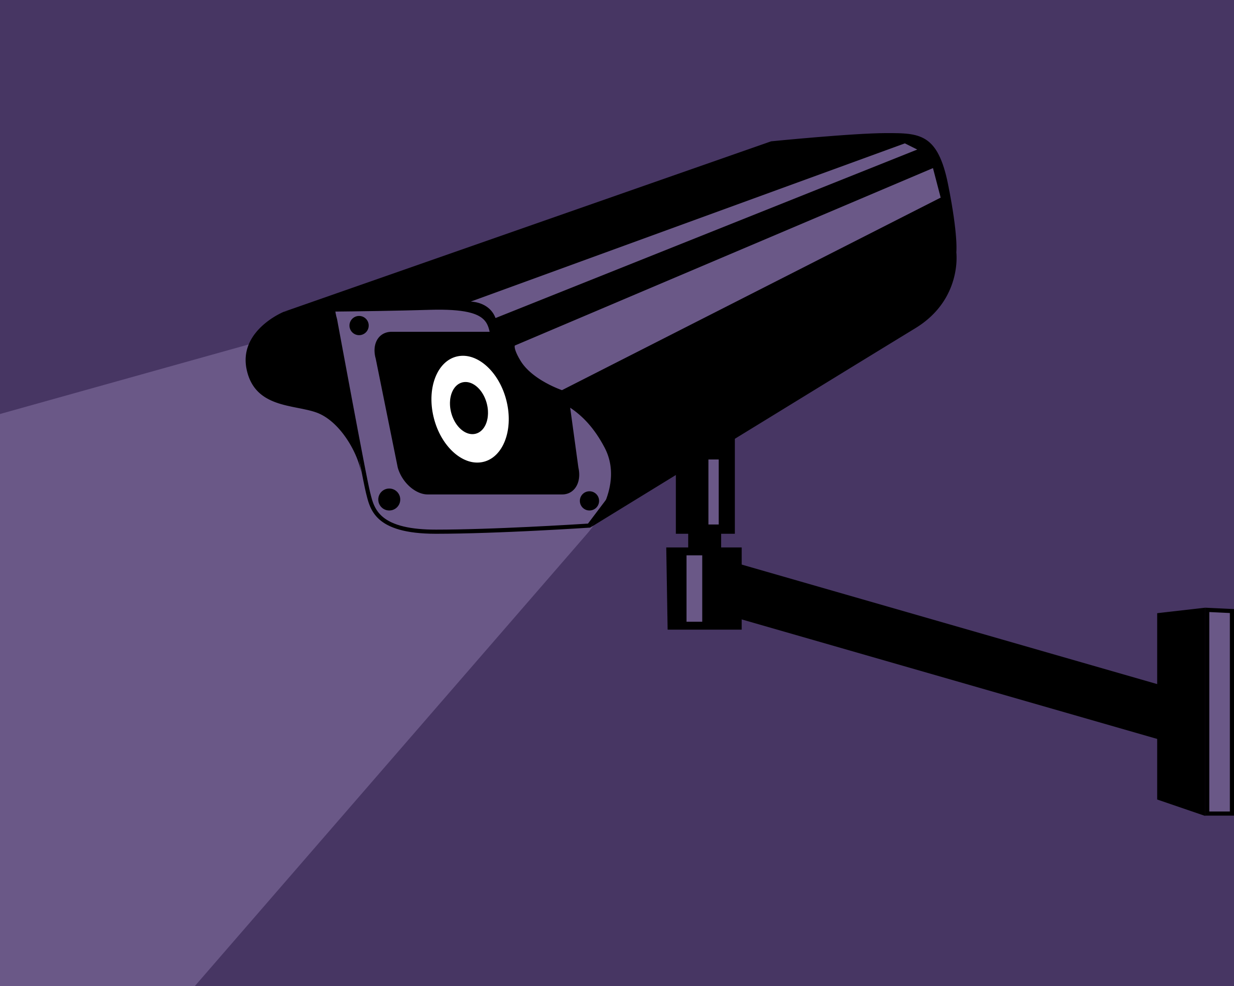

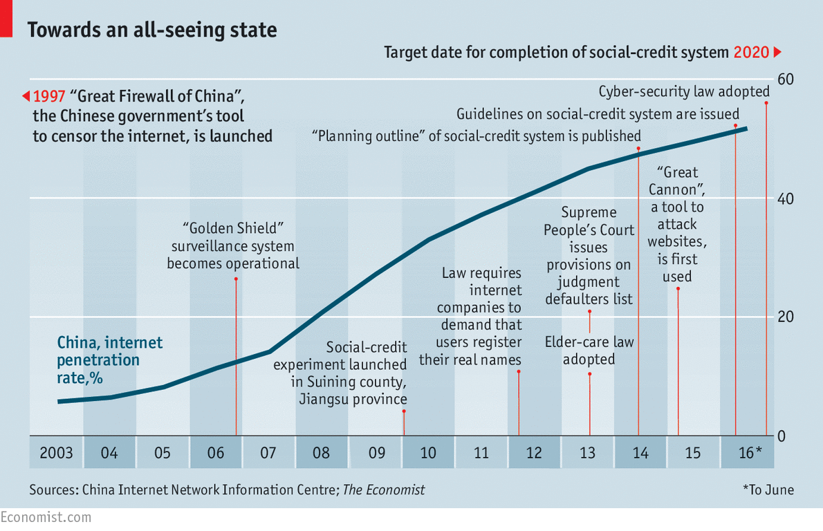
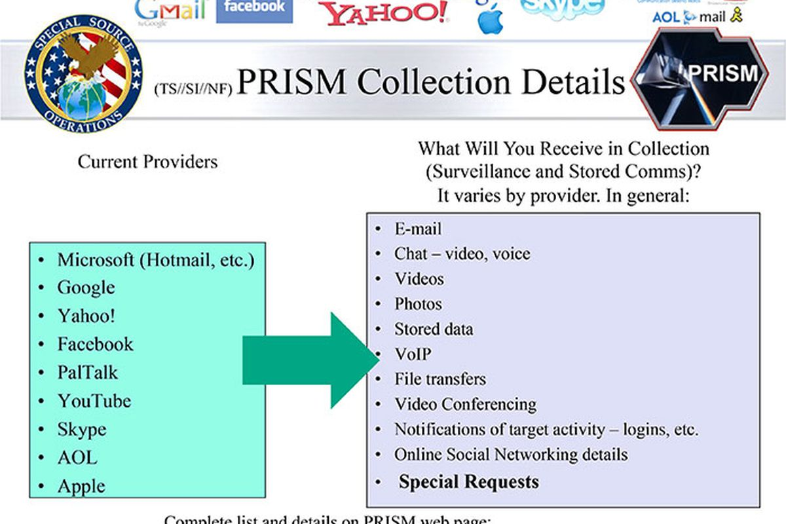
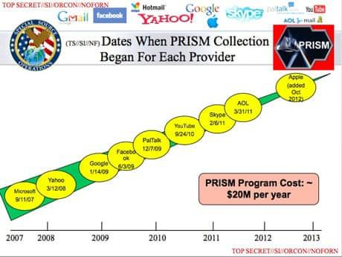
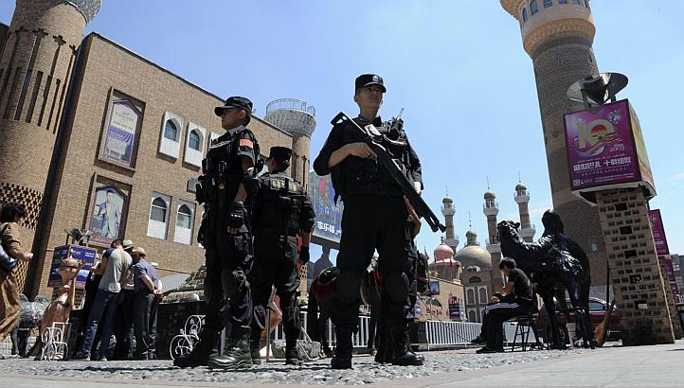

Mass Surveillance For Whom?
Donghyun Koo <dkoo2@cmu.edu>
Kun Woo Yoo <kunwooy@cmu.edu>
Introduction
Mass surveillance is the monitoring of a large group of citizens (e.g. data collection to prevent terrorism)
USA and China have widely different purposes and implementations
NSA’s PRISM collects “foreign” data from large companies (Google, Facebook, Yahoo etc) and detects anomalies
China aims to prevent Three Evils (Separatism, Extremism and Terrorism) with its mass-surveillance system
Skynet project, The Great Firewall, Sesame Credit, etc
Using these systems, China tries to bring sociopolitical stability to ethnically diverse regions and to the general society
Consequentialist
PRISM’s goal to prevent terrorism - 54 plots (2013) : Said to be one or two
Unable to prevent Boston Marathon Bombing (2013), Orlando Nightclub Shootings (2016) and Paris Attacks (2015)
Documents show New York City subway bombing plot (2009) could have been caught without PRISM
Does not achieve intended goal
Mass-surveillance system in China did bring down the general crime rate, but
in Xianjing increased oppression only led to stronger revolt
The sense of being monitored every moment leads to a great decrease in the general happiness
A recent survey found out that 76% of Chinese feel that AI is a threat to their privacy
We cannot say that the benefit of mass-surveillance outweighs its harm, whether it is openly enforced or not
Deontological
PRISM is supported by Amendments to the Foreign Intelligence Surveillance Act (FISA) : based on reasonable belief
4th Amendment protects against unwarranted searches
With such widespread mass-surveillance in China, people constantly live under the pressure that they’re being watched
By setting strict standards on how people think, act and speak, mass-surveillance system undermines the very basic human right of freedom
Every government has the obligation to embrace diversity and treat its people equally
China is trying to eradicate and sacrifice minority’s cultural identity for the majority
Conclusions
Mass surveillance is unethical
It infringes on privacy, freedom of speech, freedom of information and others
Policies must protect privacy and specify the full extent of surveillance

